Slide 1



22AIE205 - INTRODUCTION TO PYTHON
Product Popularity
Prediction
TEAM C-7
G PRAJWAL PRIYADARSHAN (24214)
KABILAN K (24224)
KISHORE B (24227)
RAHUL L S (24248)
Team – 7 AIE - C

Slide 2
Abstract
In this work, we present an approach to analyze and predict customer purchasing behavior using an online retail dataset. The proposed study focuses on two key tasks: Demand Forecasting and Product Popularity Prediction.
For demand forecasting, we employ Random Regression to estimate future sales quantities by using historical transaction records and product attributes. This results in effective product management and business planning.
For product popularity prediction, we implement a Logistic Regression model to classify products as either popular or non-popular. Together, these models provide a comprehensive framework that combines predictive analytics with classification insights, helping retailers improve supply chain efficiency, optimize stock levels, and enhance customer satisfaction.

Slide 3

Product Popularity Prediction refers to the process of predicting which products are likely to be popular (i.e., in high demand or purchased frequently) based on historical data like sales, customer behavior, and product characteristics.
Instead of labeling popularity with a simple threshold, we use a Demand Forecasting Approach, where machine learning models predict future sales of products. Based on these forecasts, products are classified as Popular or Not Popular, making the system more realistic for real-world retail.
Introduction

Slide 4
Dataset: Unlabeled UK-based retail data with product details, quantities sold, invoice dates, unit prices, and customer IDs.
Preprocessing:
Removed duplicates
Handled missing values
Aggregated data by product to compute total quantity sold, revenue, and average unit price
Labeling: Products with quantity sold above the median are labeled as ‘popular’.
Modeling: Built Random Forest, and Logistic Regression models to classify products based on popularity.

Slide 5
Objectives :
To analyze the huge online retail data for better business strategies
To identiy customer purchase behavior from transaction data
To forecast future sales of each product using regression models
To classify products as Popular or Not Popular based on predicted demand.
To support retailers in better inventory planning, marketing, and decision-making.

Slide 6
Tools & Technologies Used :
Programming Language → Python
Libraries →
pandas, numpy → data preprocessing & feature engineering
matplotlib, seaborn, plotly → visualization
scikit-learn → machine learning models (Logistic Regression, Random Forest)
Data Handling → Excel / CSV
Environment → Jupyter Notebook, VS Code
Yet to do → Flask / Streamlit for deploying a popularity prediction app

Slide 7

About Our Dataset
Online Retail Dataset
01
This is a transactional data set which contains all the transactions occurring between 01/12/2010 and 09/12/2011 for a UK-based and registered non-store online retail.
02
No of Features : 8
No of Instances : 541909

Slide 8
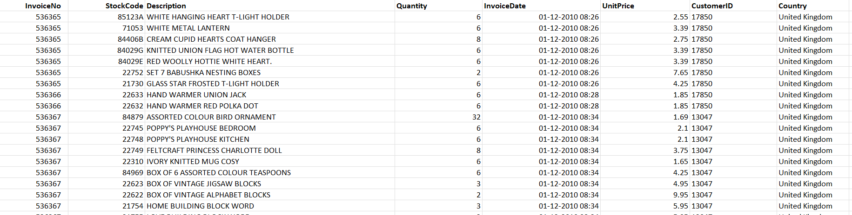
Feature | Description
InvoiceNo | 6-digit integral number uniquely assigned to each transaction. If this code starts with letter 'c', it indicates a cancellation
StockCode | a 5-digit integral number uniquely assigned to each distinct product
*Description | product name
Quantity | the quantities of each product (item) per transaction
InvoiceDate | the day and time when each transaction was generated
UnitPrice | product price per unit
*CustomerID | a 5-digit integral number uniquely assigned to each customer
Country | the name of the country where each customer resides

Slide 9
Methodologies Used :
Data Preprocessing → Cleaning missing values with no customer ID, removing cancellations, removed negative quantities.
Time-Series Aggregation → Sales grouped per product per month. [Demnad-Forecasting]
Feature Engineering → Lag features based on previous month sales.
Modeling → Train regression models (Random Forest) to predict demand.
Evaluation → Measure accuracy with RMSE, R² for sales - Demand forecasting,

Slide 10
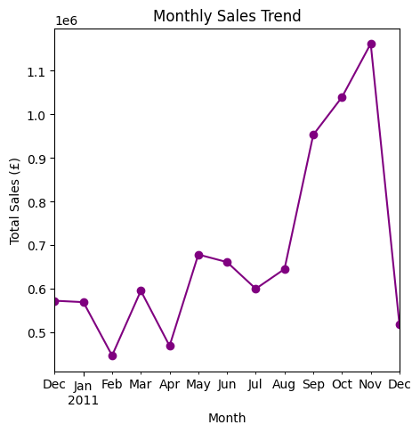
Dataset Visualization

Slide 11
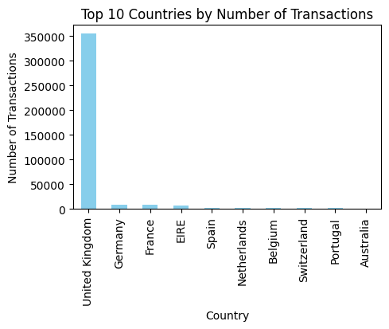
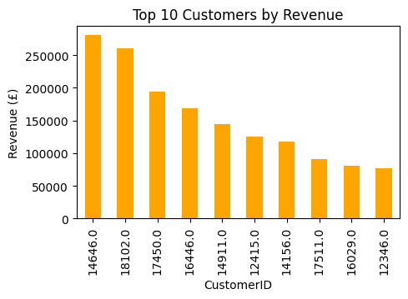
Plots representing Top 10 customer ID & Highest sales in country

Slide 12
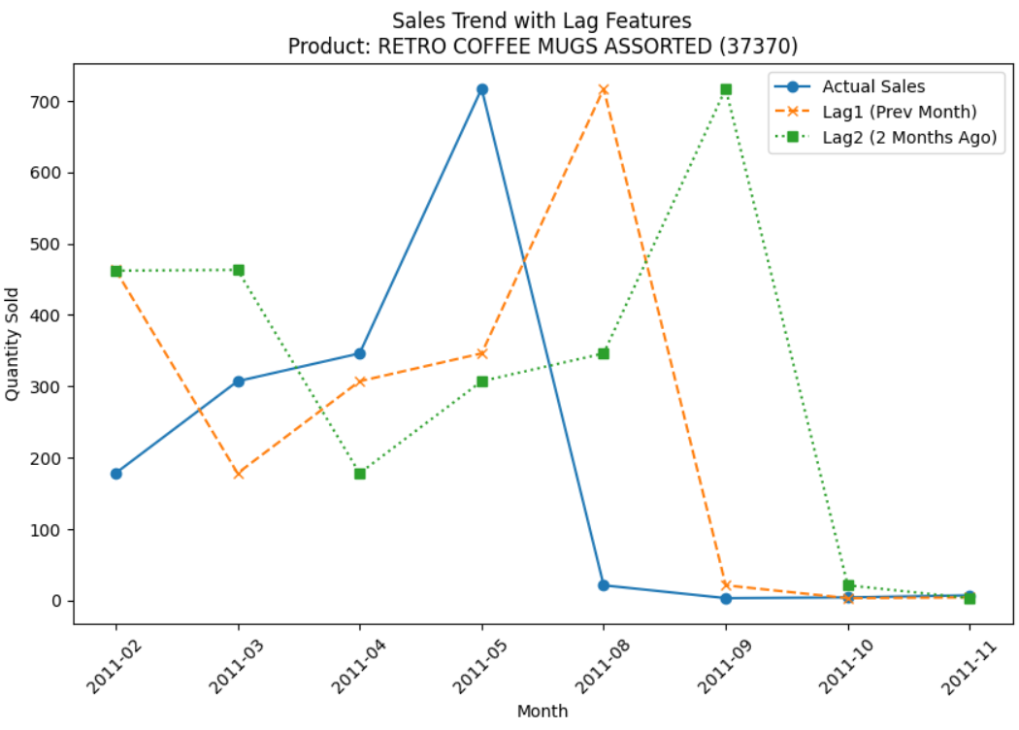
Actual Sale vs Lag feature after Feature Engineering

Slide 13
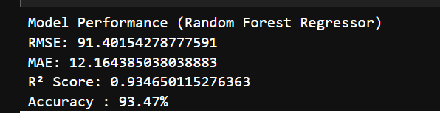
Performance Metrics

Slide 14
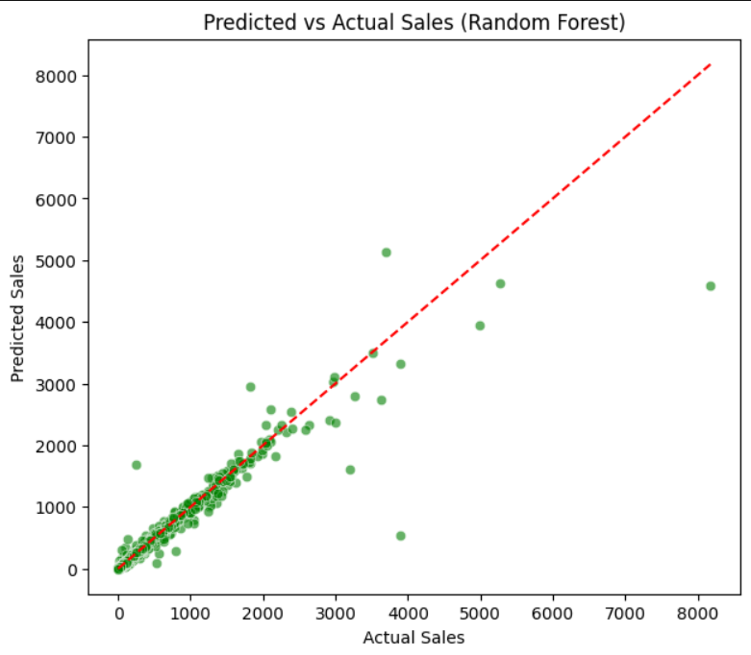
Demand Forecasting using Random Forest
What is Demand Forecasting ?
Here , we use a Demand Forecasting Approach 📈, where machine learning models directly predict the total number of quantities sold for each product in the future.
Perfect predictions lie on the red dashed line → closer points = better model performance

Slide 15
Methodologies Used :
Data Preprocessing → Cleaning missing values with no customer ID, removing cancellations, removed negative quantities & unit price.
Threshold Calculation → Using Median of the Quantity. [Popularity-Prediction]
Feature Engineering →Calculated Revenue by multiplying total quantity and
avg unit price.
Modeling → Logistic Regression model to predict Popularity.
Evaluation → Precision/Recall/F1 for product popularity prediction- classification.

Slide 16
Data Analytics :
Using Excel

Slide 17
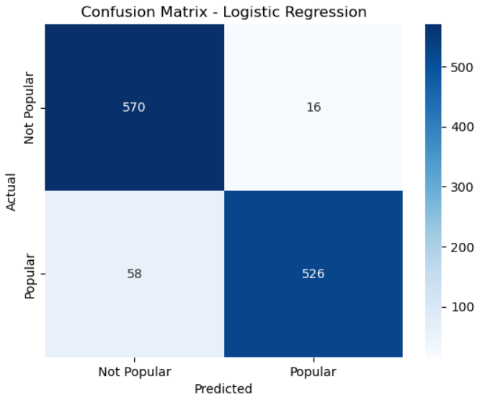
Results:
Product Popularity Prediction using Logistic Regression

Slide 18
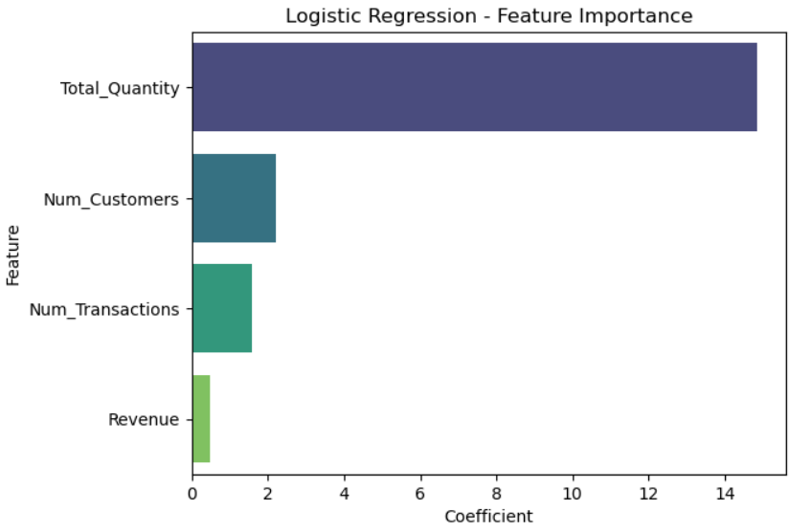
Results:
Logistic Regression - Weight coefficient Values

Slide 19

Results:
Logistic Regression -Output

Slide 20
Work Completed :
Demand Forecast Approach – used for prediction of future sale of products, no of quantities
Product Popularity prediction – Used to check whether the give description (product) is popular or not

Slide 21
Challenges and Risks :
1) Data-Related Issues
Missing or noisy data ️ → Many sales datasets (like yours) have missing CustomerID or Description.
Data imbalance️ → A few products dominate sales, while many have very low demand → models may become biased.
Short history for new products → No past sales → hard to forecast popularity/demand.
Seasonality & holidays → Sales spikes (e.g., Black Friday, festivals) are hard to model.
2) Business Risks
Overstocking → If the model overestimates demand → excess inventory, higher storage cost.
Stockouts → If the model underestimates demand → lost sales & unhappy customers.
Misclassification of popularity → Marketing budget may be wasted on wrong products.
Dynamic market changes → Sudden trends, competitor moves, or economic shifts can make past data less reliable.

Slide 22
Future Work :
For Regression we have only used one model named XG_Boost. We will try to implement with many different models
For Classification we have only used one model named Logistic Regression. We will try to implement with many different models.
Streamlit app for predicting product popularity using Logistic Regression, thus by entering a product description to check if it's predicted as "Popular" or "Not Popular".

Slide 23
Conclusion :
This project uses transactional data from the Online Retail dataset to predict product popularity & Demand Forecasting Approach with Machine Learning.
In today's competitive retail world, knowing what customers prefer and predicting demands crucial.
By identifying popular products early, retailers can improve customer satisfaction, avoid over stocking or stockouts, and increase profits through better personalized marketing and inventory management.

Slide 24

Thank you!

